Slide 1
Presentation of Capstone Project Statement Healthcare Claims Quality & Compliance Platform
Joseph Laurence C. Tajan
Batch 1

Slide 2
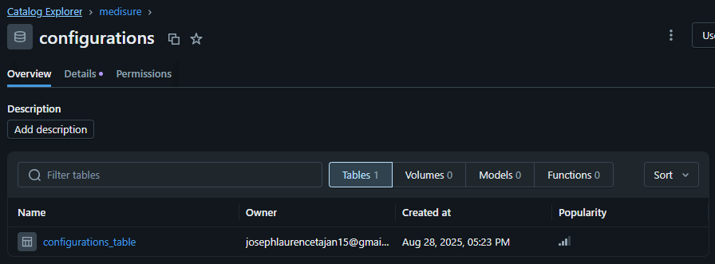
CATALOG TABLEs - CONFIGURATIONS

Slide 3
Overview of the project
Listed below are all Databricks Notebooks used by the pipeline to automate the ETL process:
Config – config_init, config_tables, config_setip
Bronze – 00_files_landing, 01_ingest, 02_archive
Silver – 00_clean, 01_transform_claims_batch
Gold – 00_curate

Slide 4
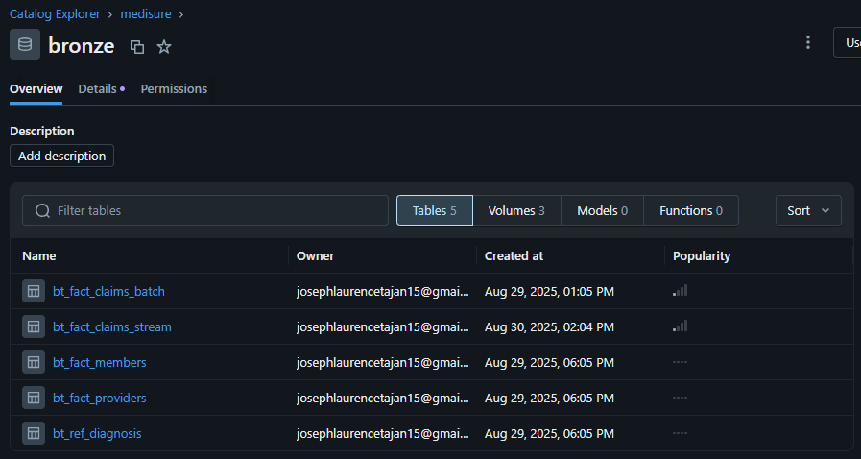
CATALOG TABLEs - BRONZE

Slide 5
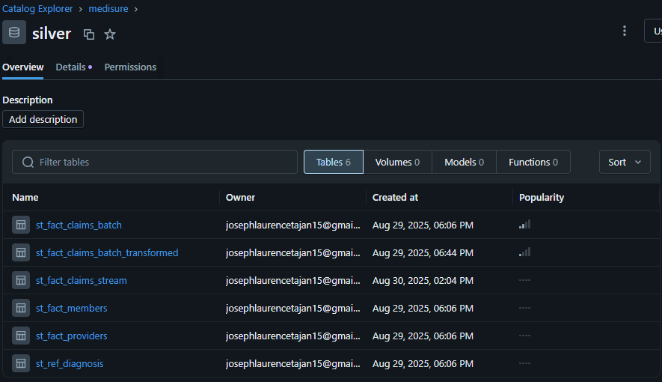
CATALOG TABLEs - SILVER

Slide 6
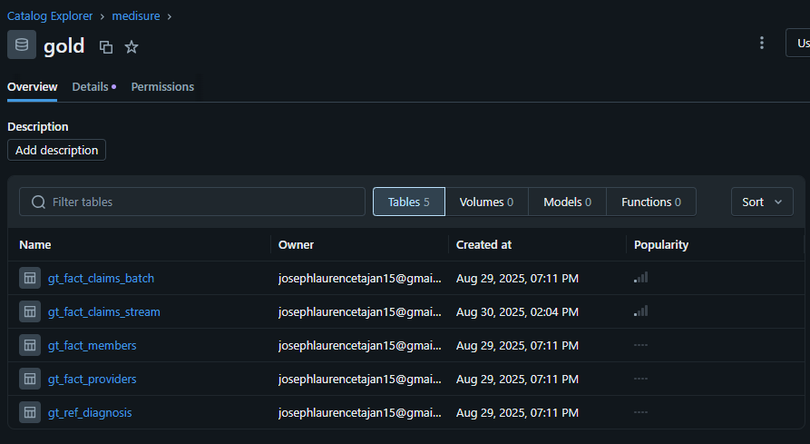
CATALOG TABLEs - GOLD

Slide 7
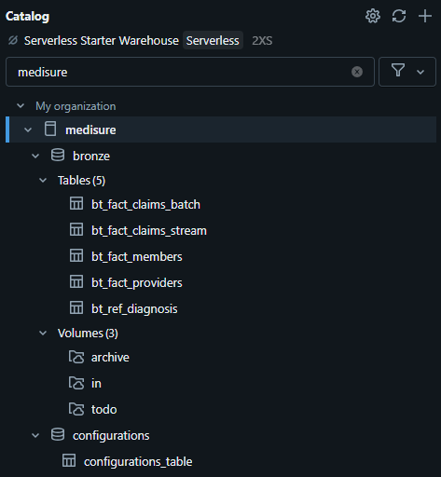
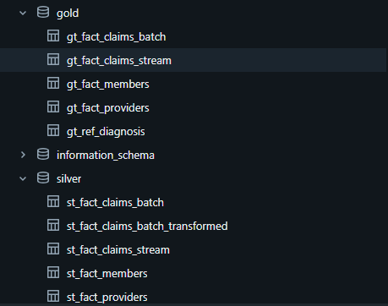
VOLUMES AND CATALOG OVERVIEW

Slide 8
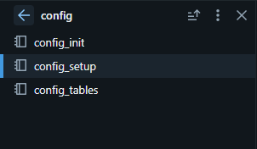
CONFIG
The config part of the pipeline contains the user defined functions, setup of our configurations and creation of our catalog tables.

Slide 9
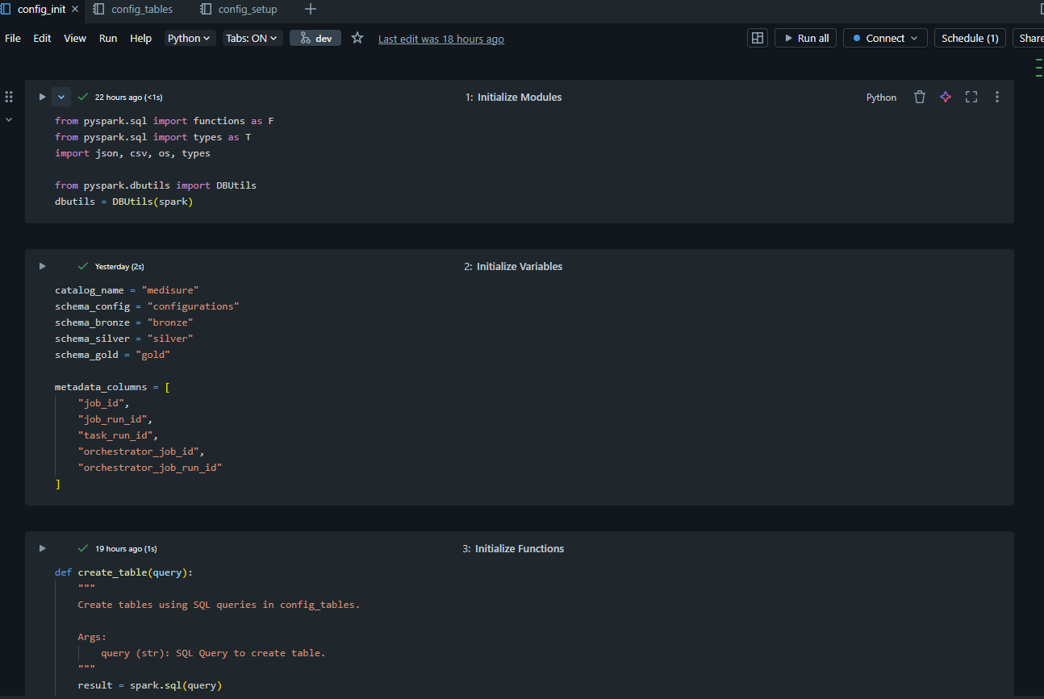
CONFIG_INIT
Config_init or config initialization contains the python/pyspark modules, as well as global variables to be used by the other notebooks for our pipeline. All of the defined functions can also be found here. These functions are user defined processes that are used multiple times throughout different notebooks.

Slide 10
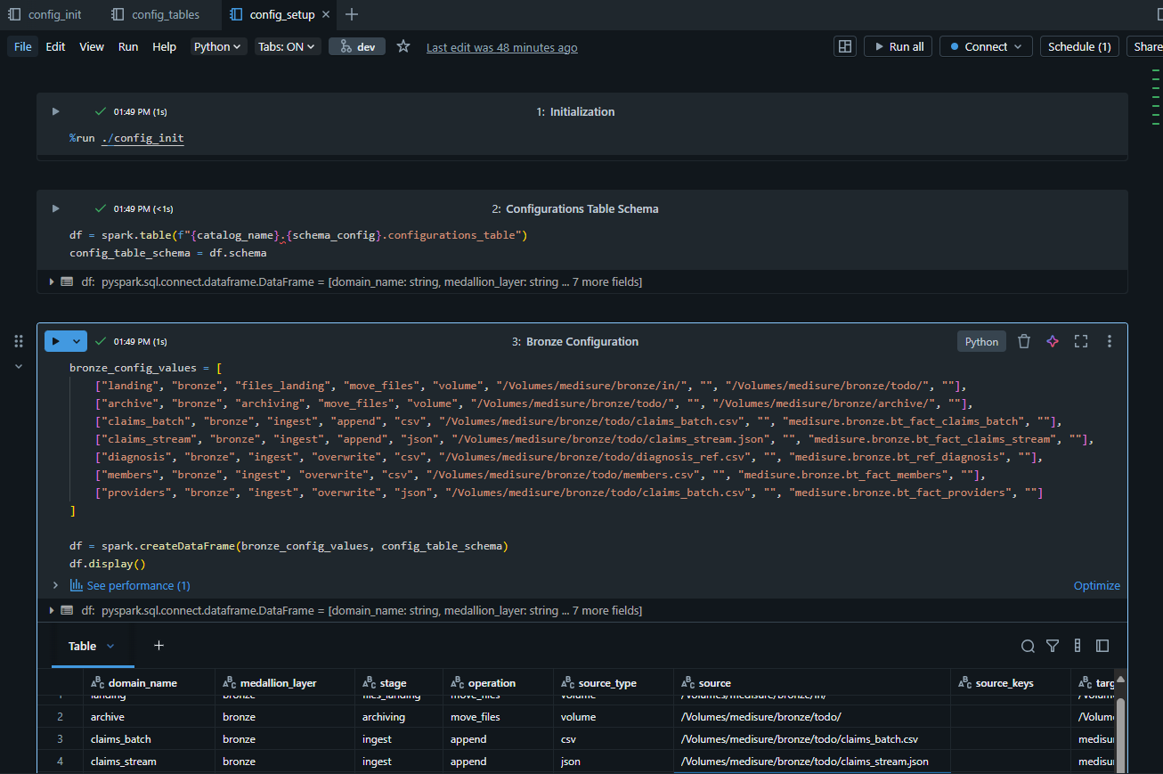
CONFIG_SETUP
Config_setup contains lists of predefined values that will be referenced by other notebooks in other job runs. These values will be inserted to a table called configurations_table and will be pulled into dataframe so that these values called and filtered to push down the correct variables to other notebooks.

Slide 11
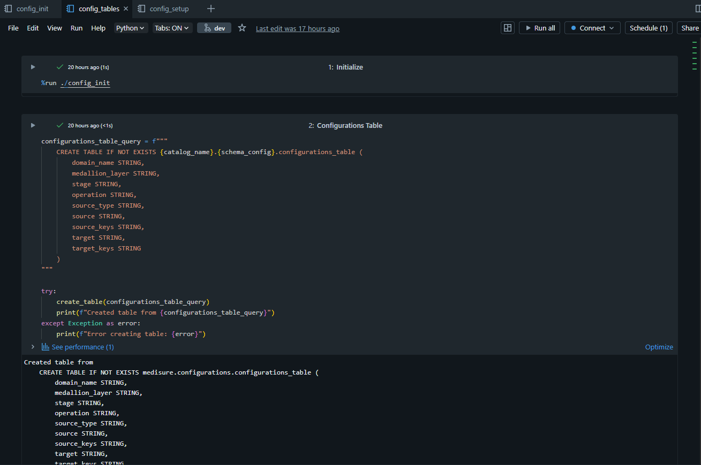
CONFIG_TABLES
Config_tables contain SQL queries that create all the catalog tables to be used for the pipeline.

Slide 12
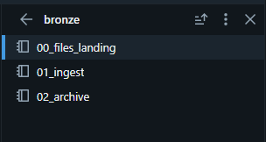
BRONZE
The bronze part contains the notebooks that will move our raw files from IN folder to TODO folder. IN folder is the default landing folder when we receive the raw files and TODO folder is the folder for the files we want to undergo the ETL process. Data from these raw files will be ingested into bronze tables and after ingesting, the raw files will be archived for safekeeping.

Slide 13
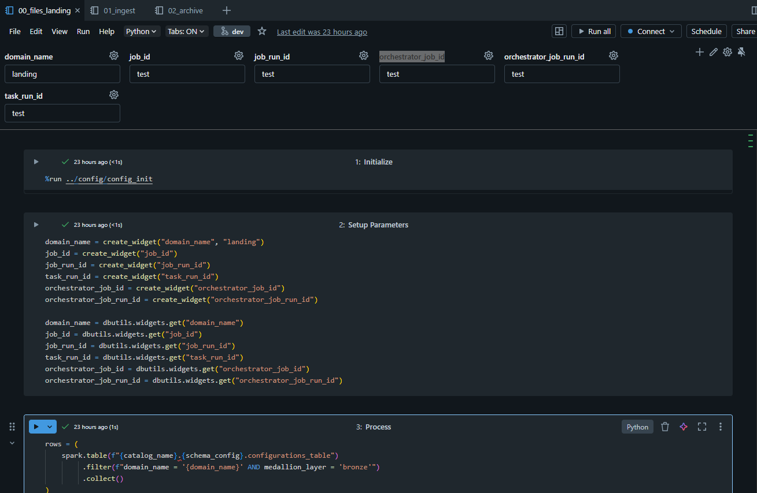
BRONZE
Starting from 00_files_landing, you will see widgets being created. These widgets will be utilized by each notebook to identify and separate each single instance of job run and task run for every time we run our pipeline, to be used by the developers to identify each separate run. In 00_files_landing, the notebooks in IN folder will be moved to TODO for ETL processing.

Slide 14
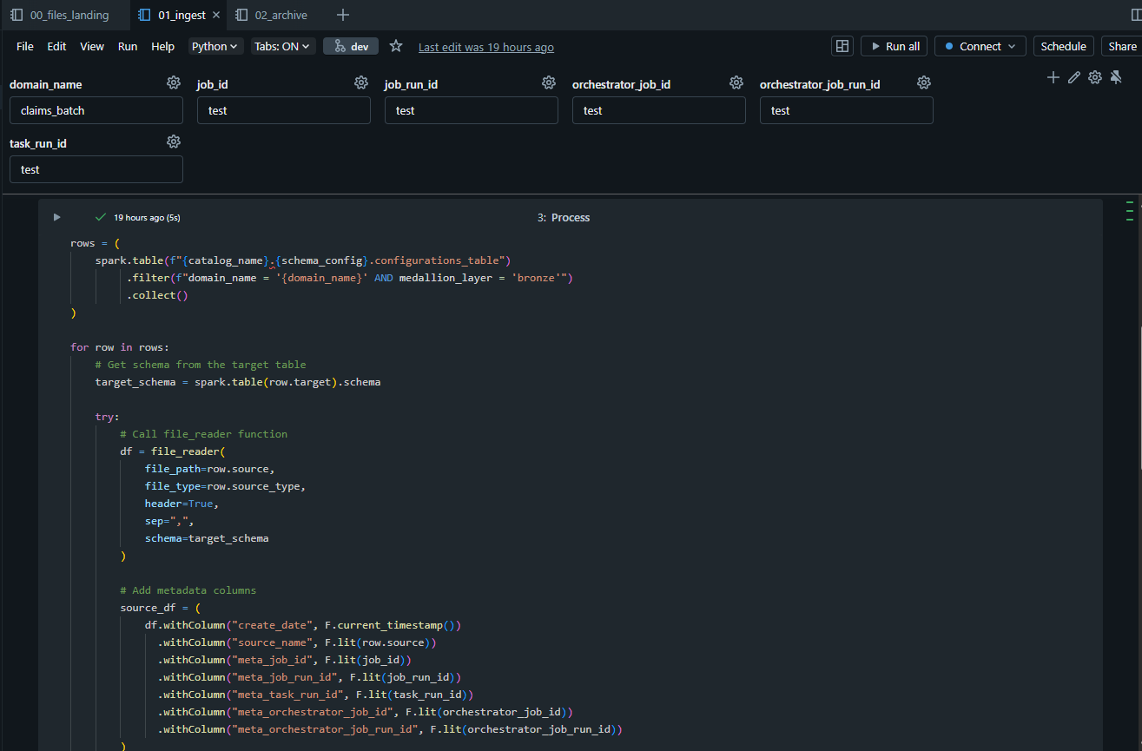
BRONZE
In 01_ingest, the data from the raw files will be ingested to the bronze tables in the bronze schema of our medisure catalog. To ensure dynamic ingestion, we make use of the variables in configurations_table to ensure the source and target tables are aligned, as well as the filetype to be ingested is correctly processed.

Slide 15
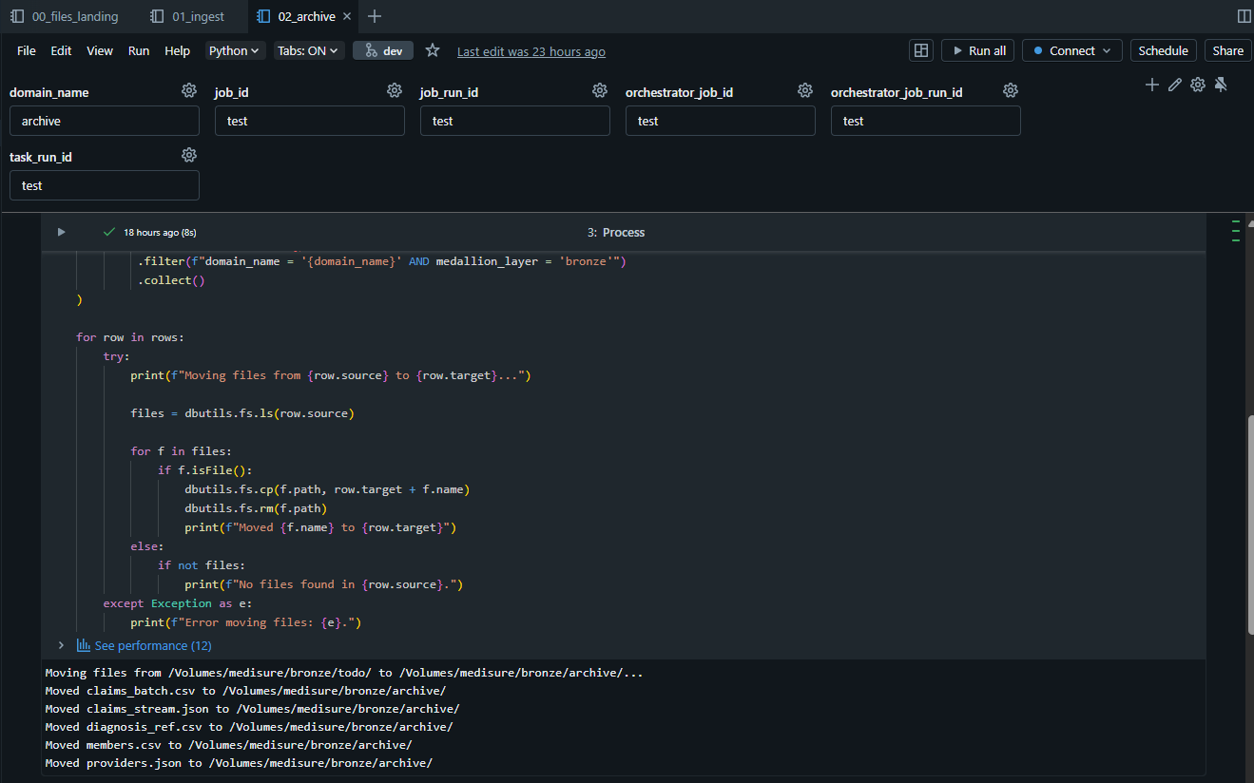
BRONZE
In 02_archive, when the raw files are done processing, they will be moved into the ARCHIVE folder.

Slide 16

SILVER
The silver part, by default, will only contain the 00_clean portion where data from the bronze tables will be clean (deduplication of rows, casting to correct schema, dropping of null rows) then inserted (either overwrite/replace/append) to the silver tables. Any transform notebook will be done as required by the client. For this case, one example is prepared in the form of 01_transform_claims_batch.

Slide 17
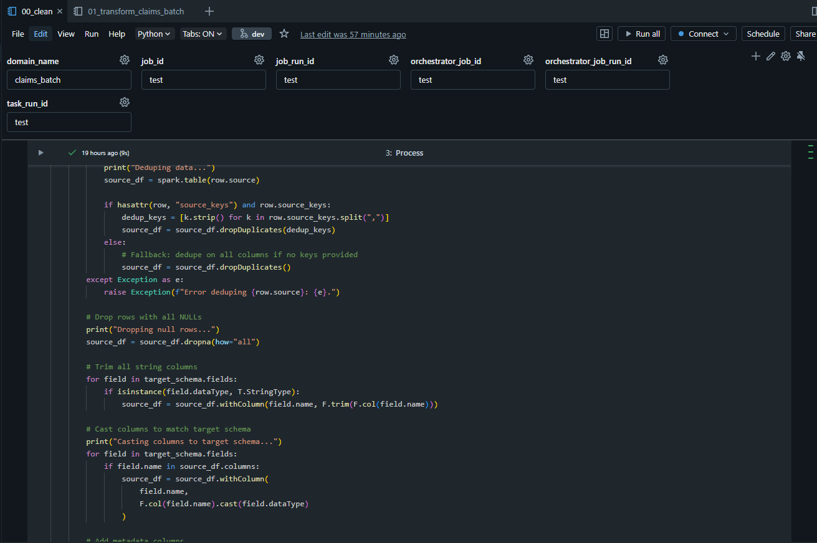
Silver
In 00_clean, data from bronze tables will be cleaned. When cleaning this data, we also consider the correct schema, which is defined by what datatypes are used by the silver table. Rows that do not follow the schema will be dropped in dataframe before insertion to silver. The same is true for duplicate rows and null rows.

Slide 18
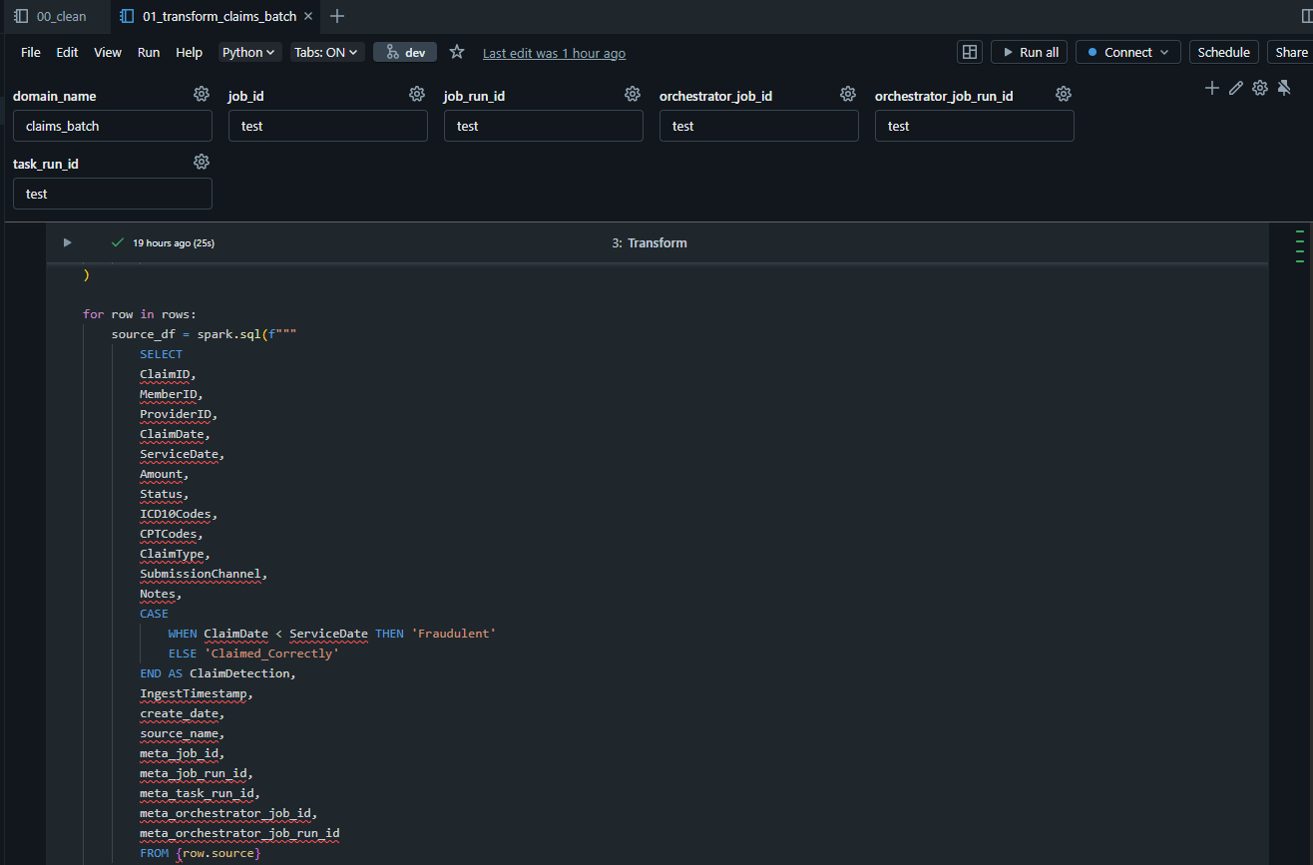
Silver
Transformations for the silver data will be done depending on what tables need transformation. In this example, 01_transform_claims_batch will use the clean claims_batch data and add a column called ClaimDetection to check wether we have valid claims. We assume claims that have a ClaimDate before ServiceDate are 'Fraudulent' as there should be no claim if it has not been serviced yet. This example shows a simple transformation only for one domain_name, but if need be, the other tables can also have their own transform scripts.

Slide 19
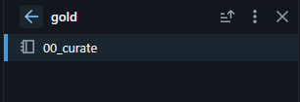
GOLD
The gold part is the last part of our pipeline. When all transformations and cleaning of our data is done in silver layer, data from the silver or silver transformed tables will be "curated" or inserted to gold tables. Gold tables will hold this data so that it can be used to created reports by third party applications such as SAP BO or PowerBI, or by using the available DBK Dashboards.

Slide 20
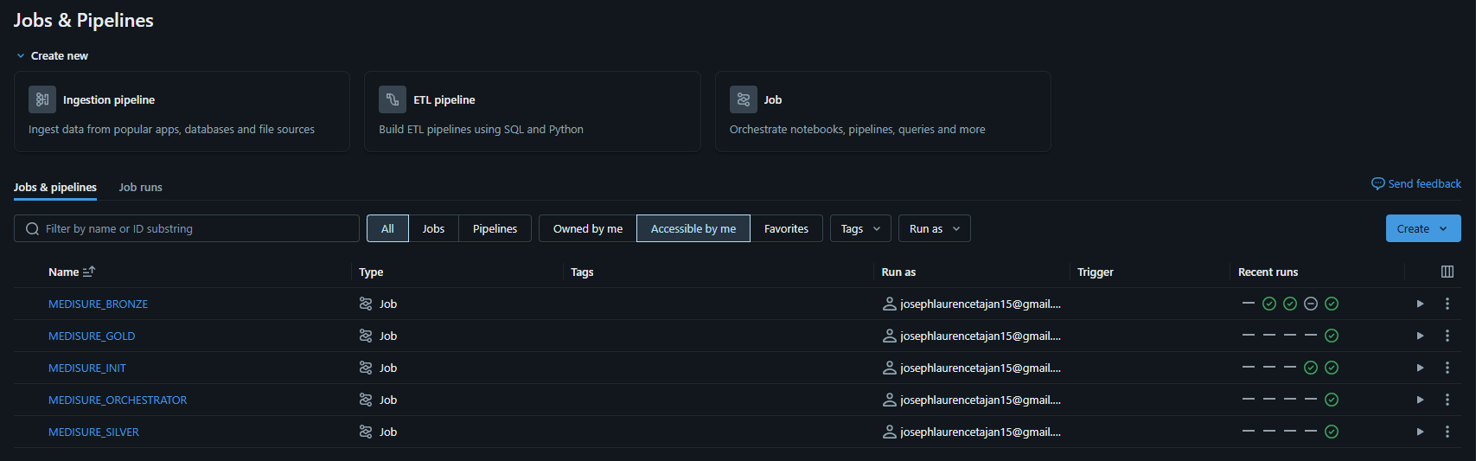
JOBS & PIPELINES

Slide 21
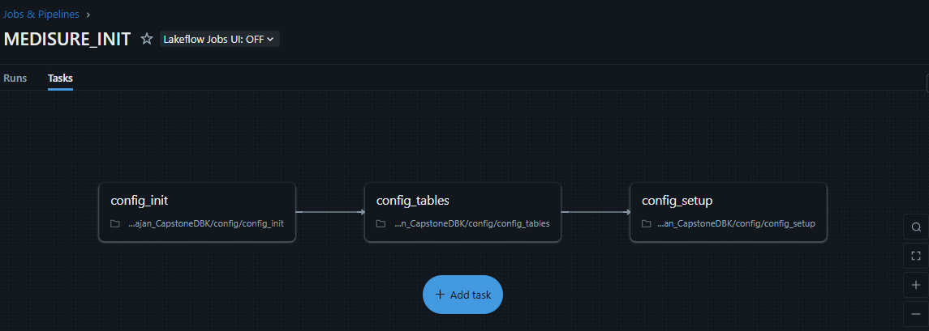
MEDISURE_INIT PIPELINE
Pipeline containing the INIT notebooks. This is only manually run as the only time this pipeline is run is when making changes to the configurations of our tables or variables in configurations_table. Metadata columns will not be used in this pipeline as we want to overwrite our configurations_table every time we make these changes. Results for each pipeline run will be provided for better viewing.

Slide 22
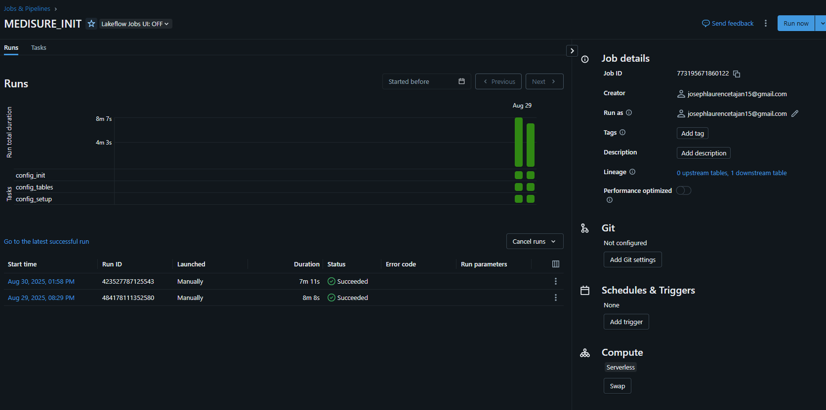
MEDISURE_INIT PIPELINE RUNS

Slide 23
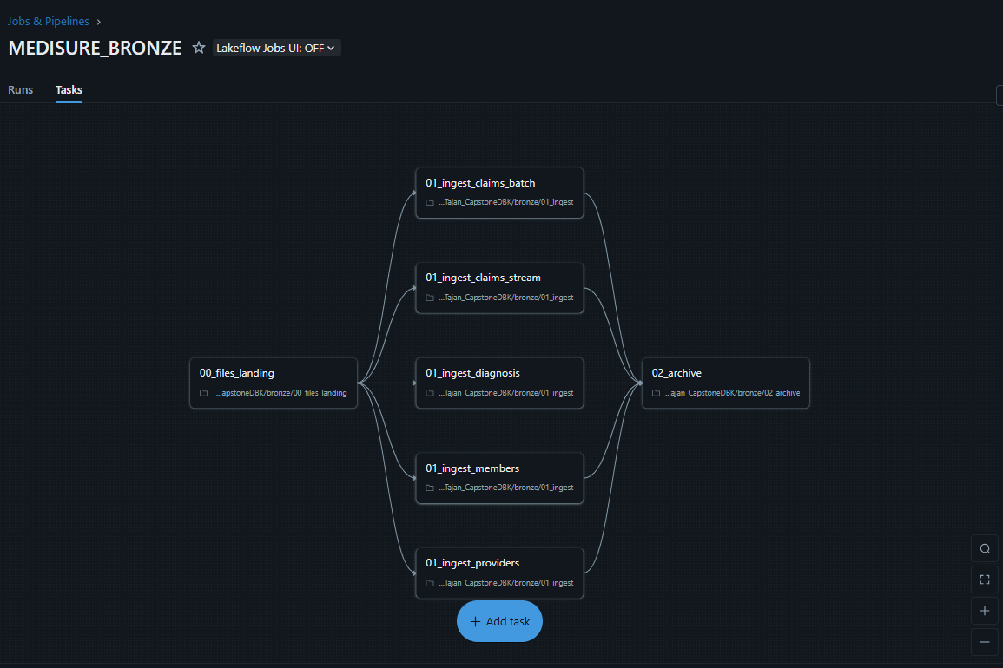
MEDISURE_BRONZE PIPELINE
Pipeline containing the BRONZE notebooks. As seen in the image above, the five tasks for each domain name (named after each different file containing different data) will run in parallel after moving the files from IN folder to TODO. The volume containing these folders can be located under bronze schema in medisure catalog. There is only one ingest notebook. This will use parameters to push down the appropriate domain name as well as metadata IDs to be used by each task to run in parallel.

Slide 24
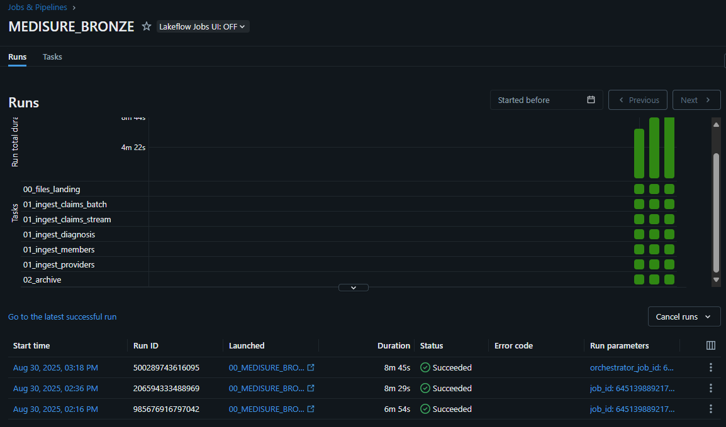
MEDISURE_BRONZE PIPELINE RUNS

Slide 25
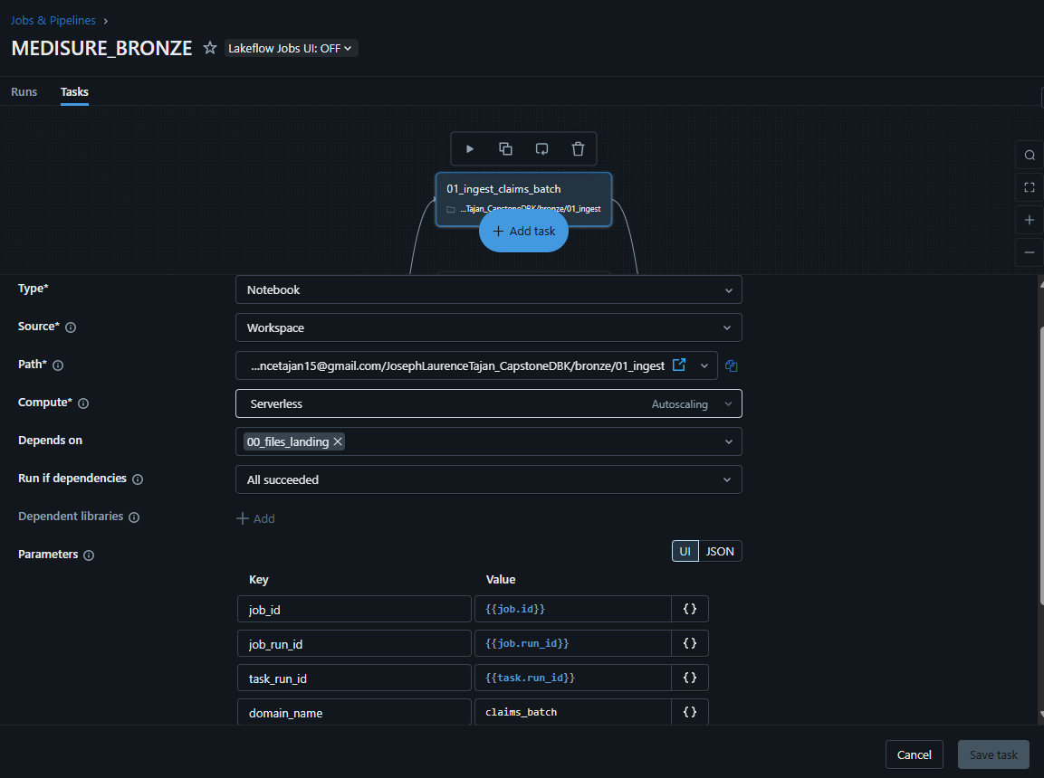
MEDISURE_BRONZE TASK SAMPLE

Slide 26
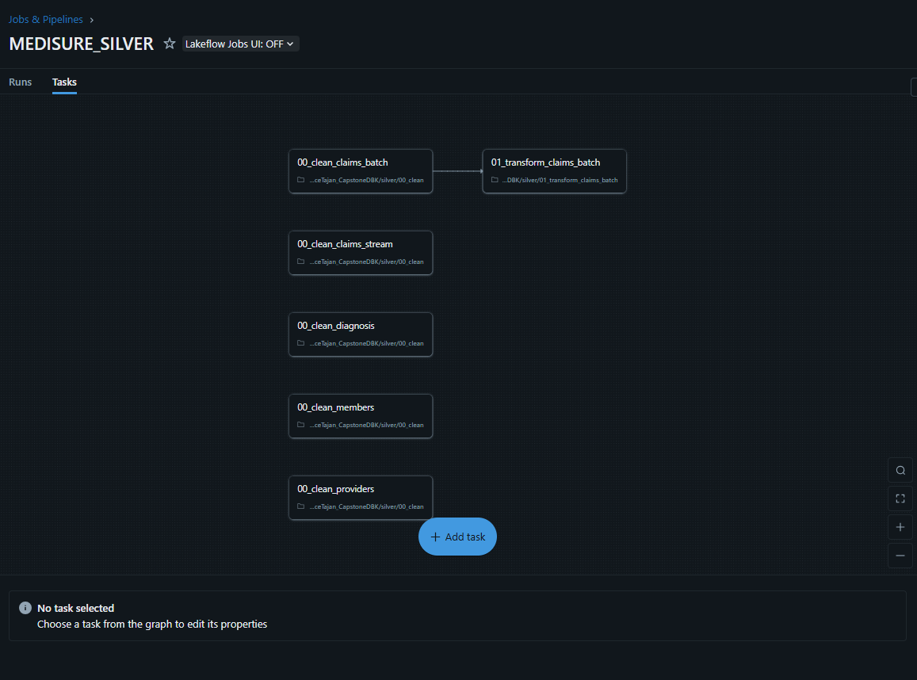
MEDISURE_SILVER PIPELINE
Pipeline containing the SILVER notebooks. As seen in the image above, the five tasks for each domain name will run in parallel. For domain name claims_batch, since it has a transformation, it will have an additional task after cleaning, running the 01_transform_claims_batch script. 01_transform_claims_batch task is only dependent to its clean counterpart and does not wait for the other clean tasks to finish in order to run and has the domain name hard coded in its script.

Slide 27
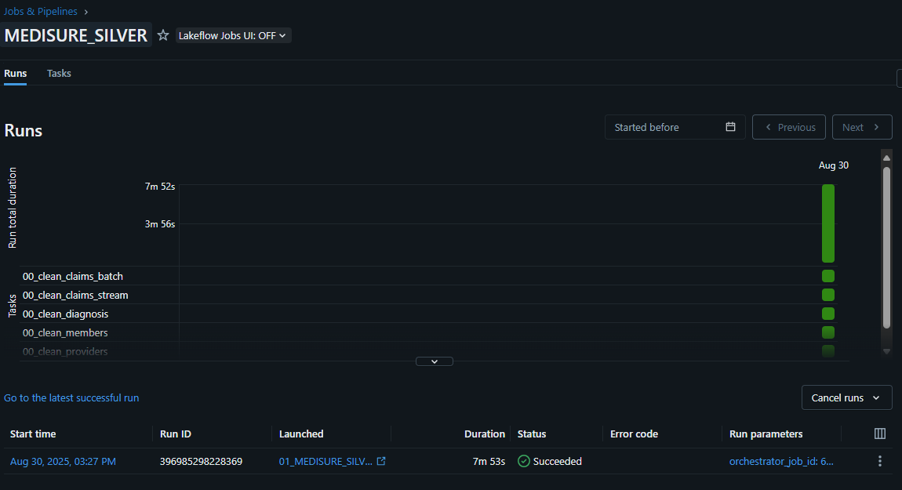
MEDISURE_SILVER PIPELINE RUNS

Slide 28
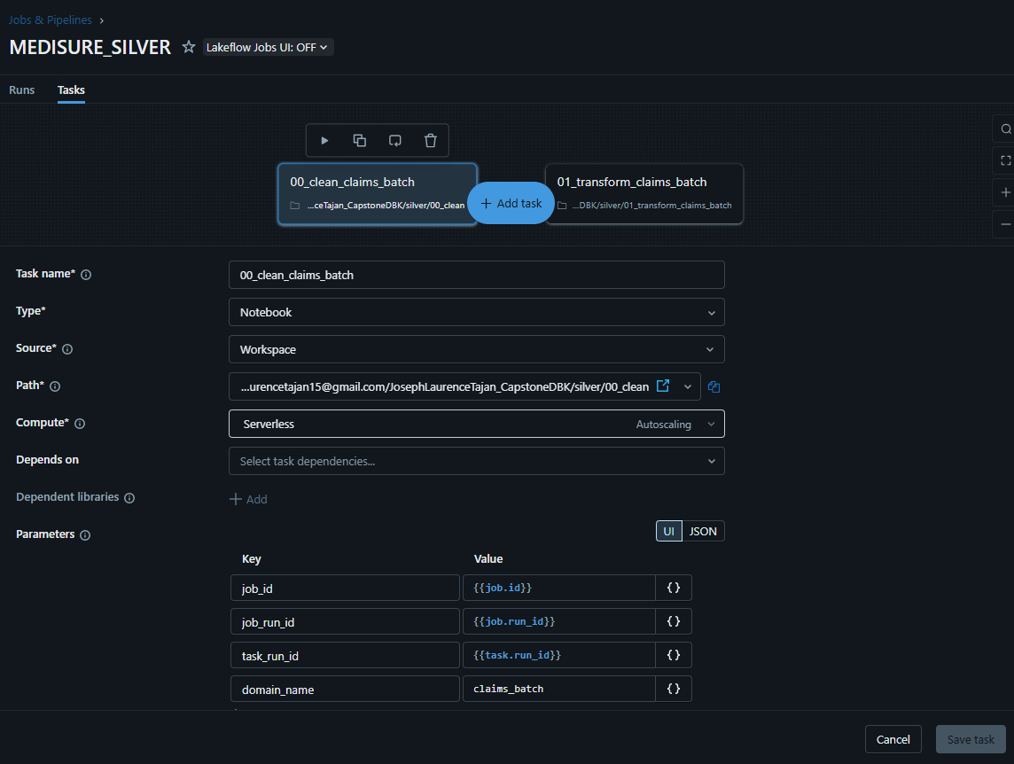
MEDISURE_SILVER TASK SAMPLE

Slide 29
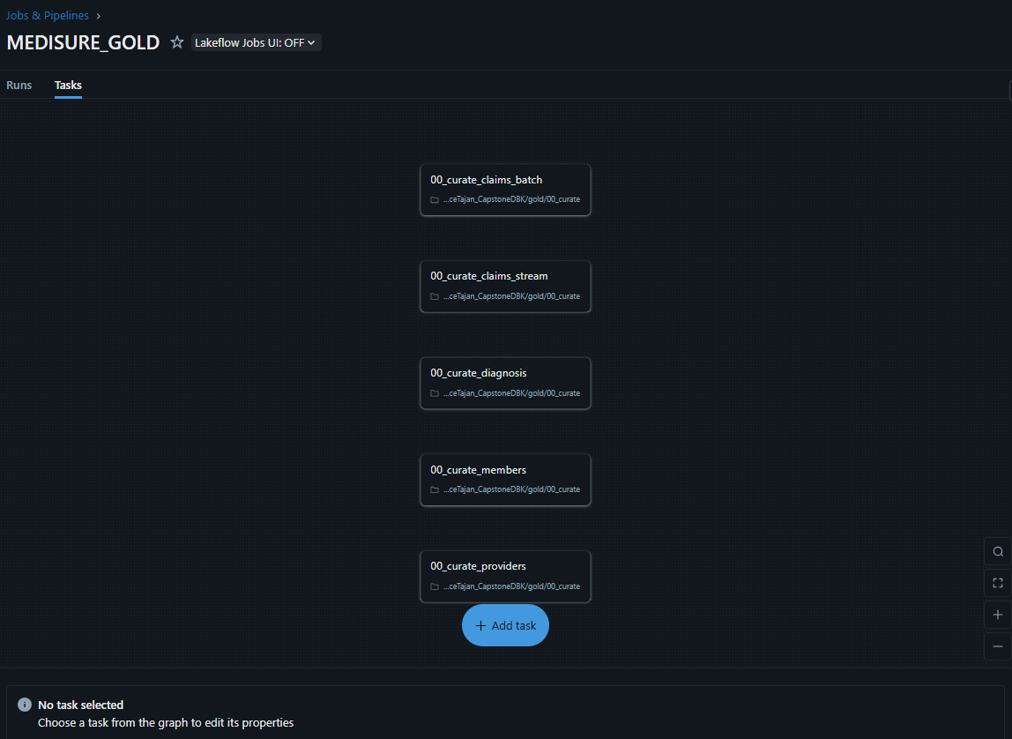
MEDISURE_GOLD PIPELINE
Pipeline containing the GOLD notebooks. As seen in the image above, the five tasks for each domain name will run in parallel.

Slide 30
MEDISURE_GOLD PIPELINE RUNS

Slide 31
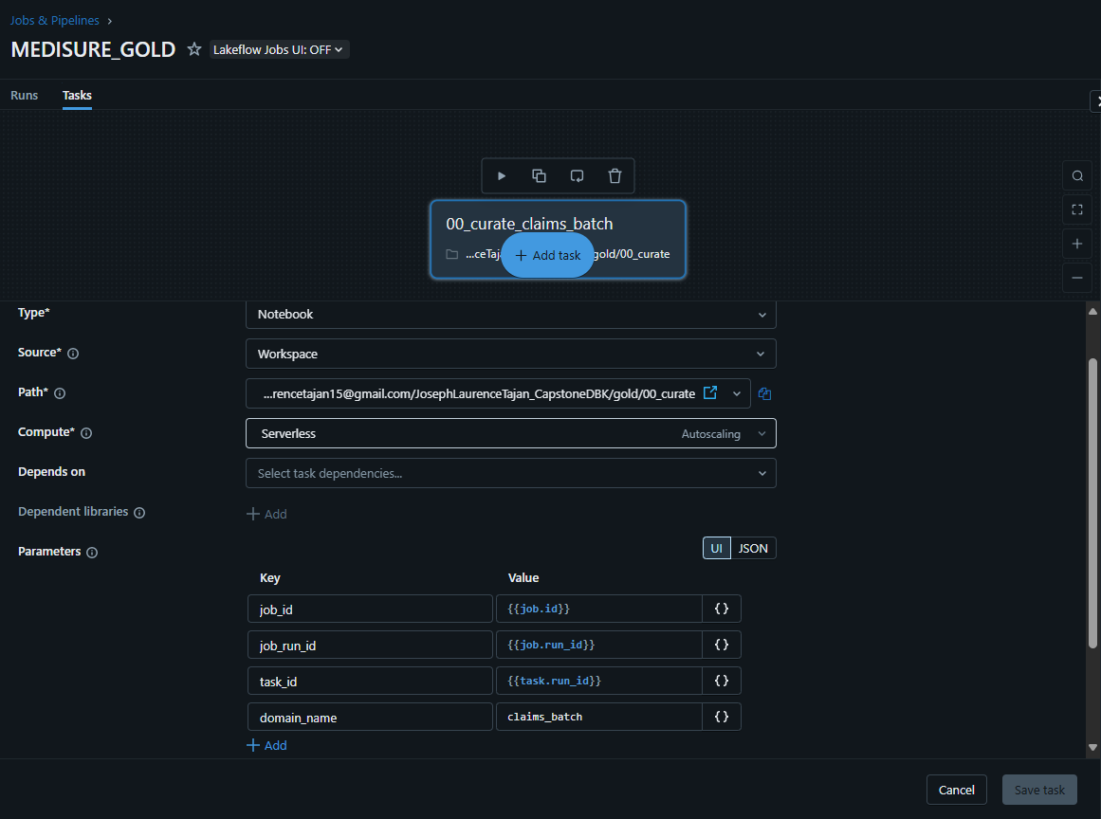
MEDISURE_GOLD TASK SAMPLE

Slide 32
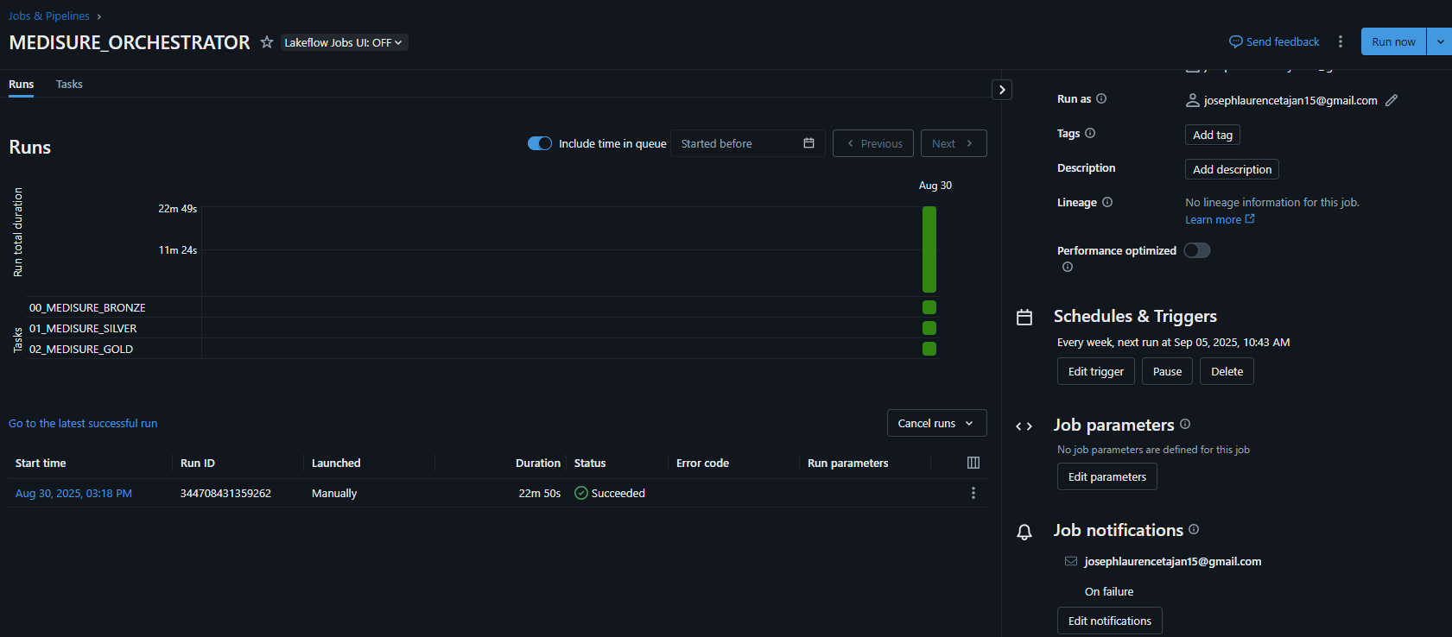
MEDISURE_ORCHESTRATOR PIPELINE
Pipeline containing the job for each layer. This job will have the job notifications and schedules/triggers settings as it contains all the necessary jobs for the entire process.

Slide 33
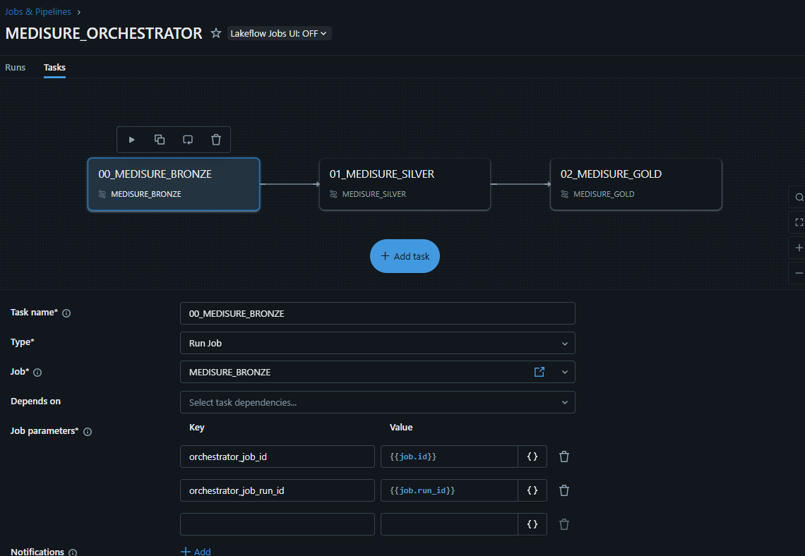
MEDISURE_ORCHESTRATOR PIPELINE/TASK SAMPLE

